Slide 1
Oregon State Forest Fires
An exploratory analysis on the general causes and acres burned over between 2012-2022
Group 6 - Ethan Shipman & Avery Javier

Slide 2
The Questions
Is there an increasing trend of forest fires in Oregon?
Where are the fires most commonly prevalent?
What are the most common causes of these fires?

Slide 3
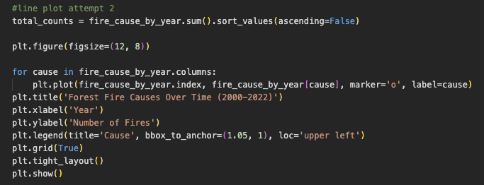
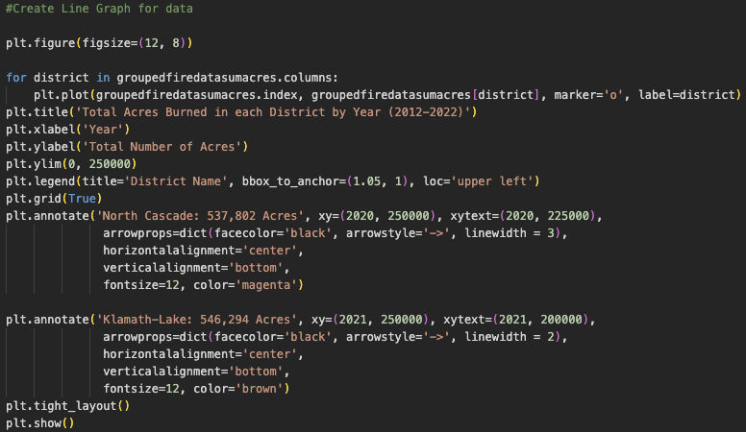
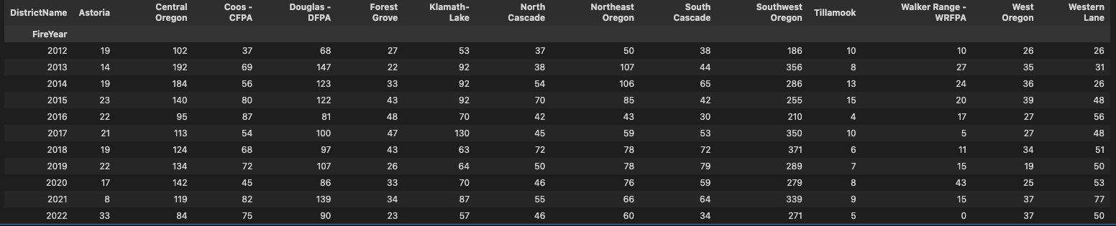
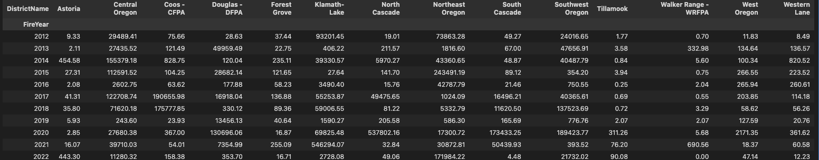
The Data
The Source
The Clean-Up
The Exploration
The data was collected via Data.gov - The public dataset was collected by Oregon Department of Forestry covering 22 years
Utilizing Pandas, we extracted over 23,490 individual fires recorded by the dataset

Slide 4
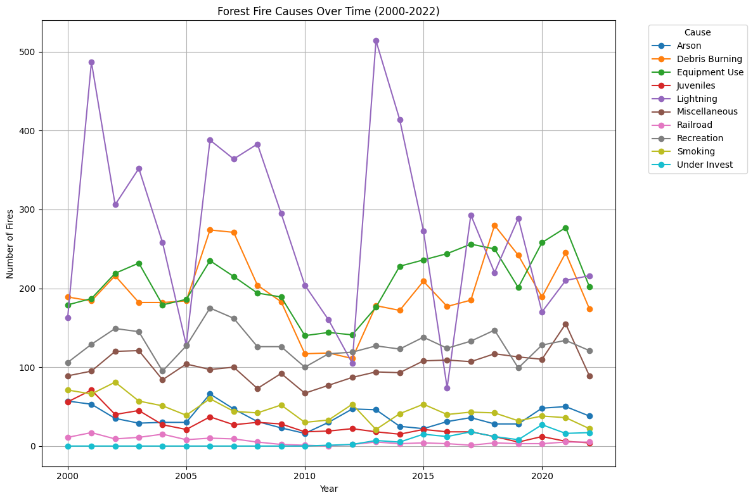
The Findings
This line plot clearly tells a story about the major causes of forest fires, including lightning, debris burning, equipment use, etc.

Slide 5
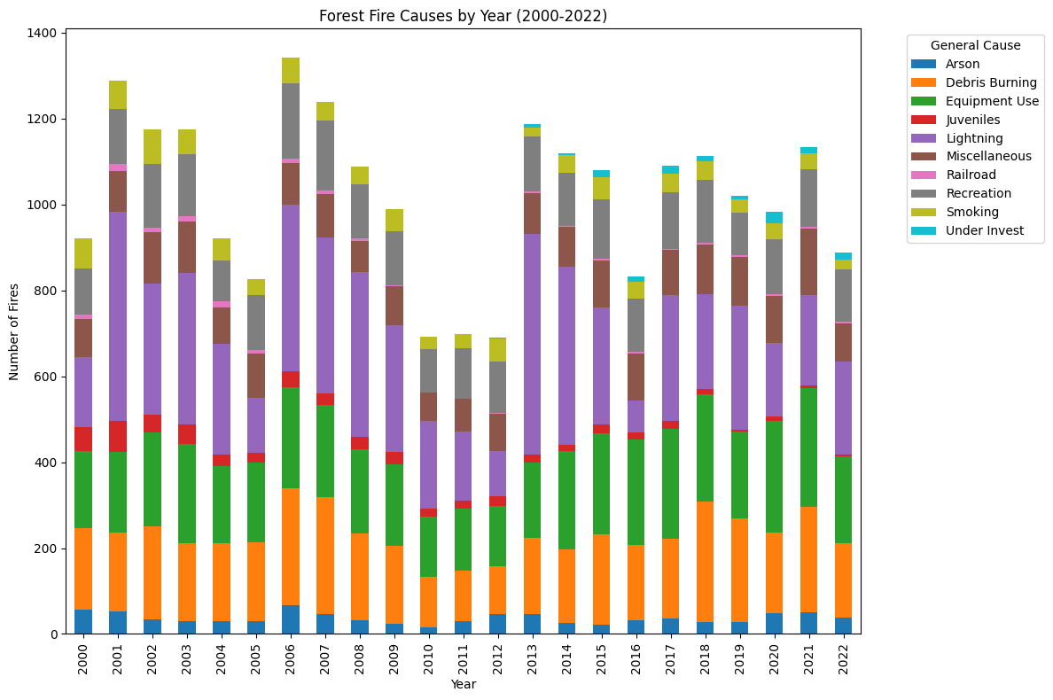
The Findings
Utilizing a stacked bar chart, we are able to see, in addition of lightning, how many fires are started each year by negligence

Slide 6
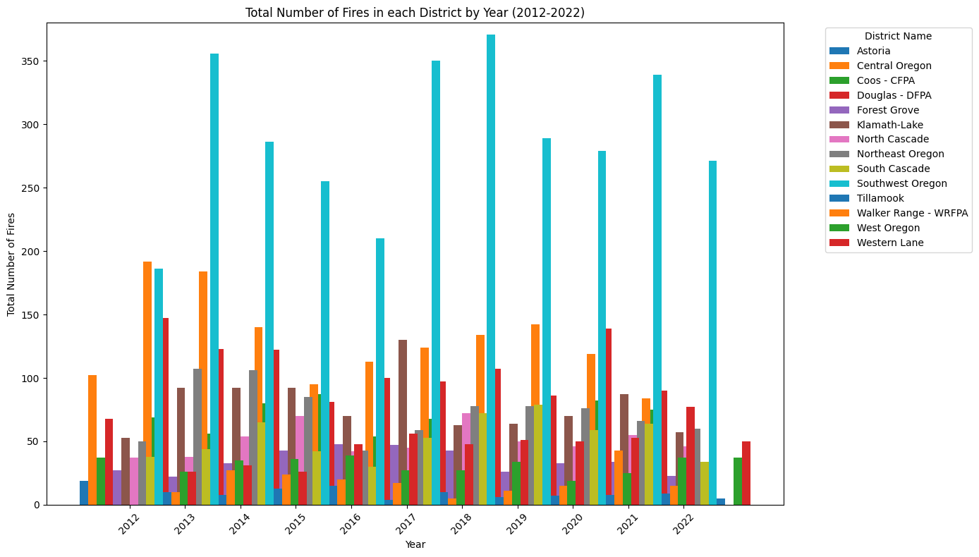
The Findings
This grouped bar chart displays the concentration of fires across the state, broken up into 14 districts, clearly showing which of them are more susceptible to fires

Slide 7
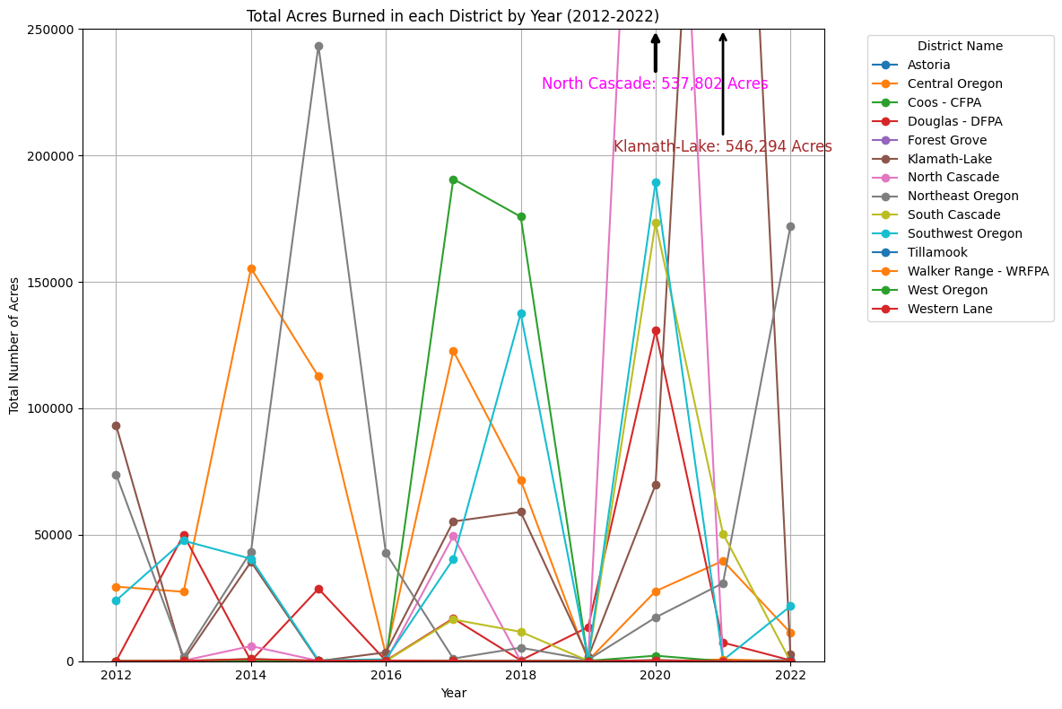
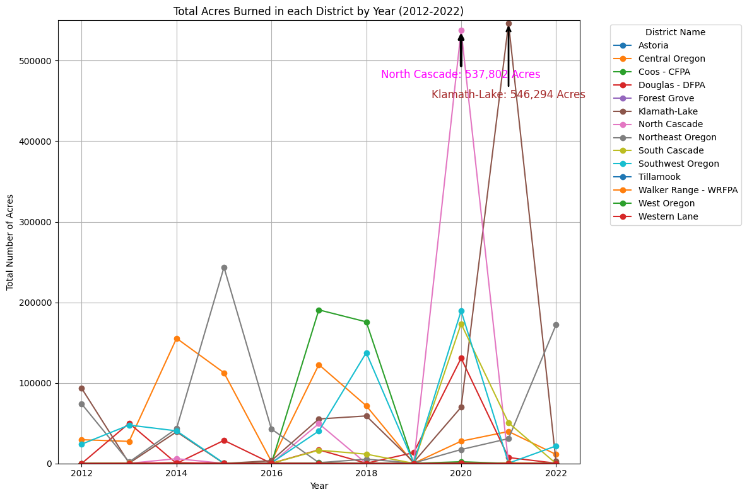
The Findings
This line plot shows the total acres burned in each district. Something interesting to notice, the total acreage doesn’t necessarily correlate with the number of fires on the previous slide

Slide 8
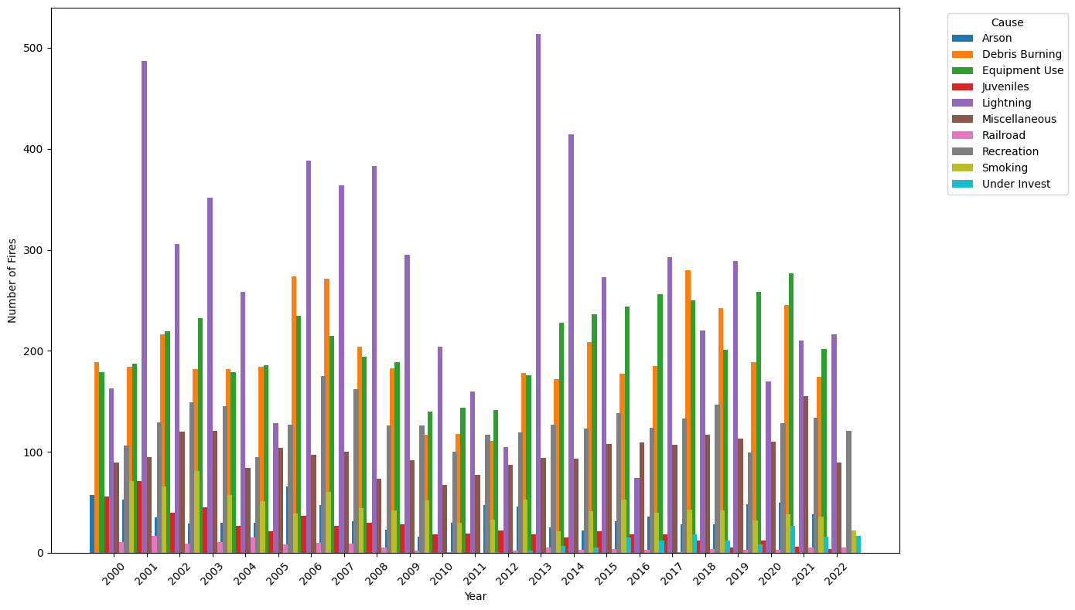
The Findings
In this chart, you can clearly see that while lightning is usually the most common cause, some years, human negligence such as debris burning and equipment use have more fires than lightning

Slide 9
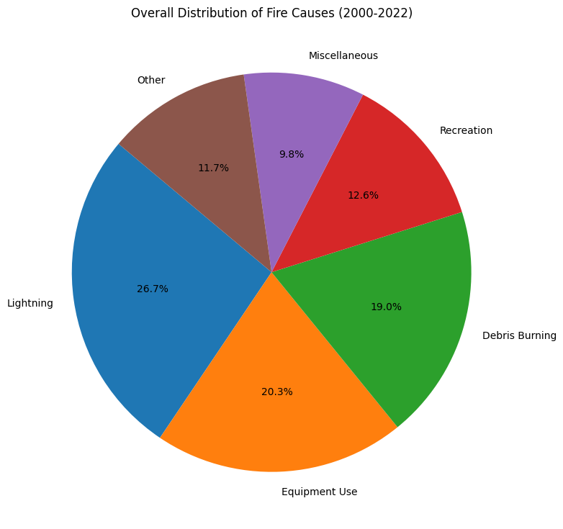
The Findings
As you can see with this pie chart, equipment use alone makes up 1/5 of the fires that have been caused in 22 years

Slide 10
The Conclusions
Is there an increasing trend of forest fires in Oregon?
Despite what people may believe, there is no trend showing any increase OR decrease in Oregon forest fires from 22 years, on.
Where are the fires most commonly prevalent?
The fires appear to be far more prevalent in Southwest and Central Oregon.
What are the most common causes of these fires?
While lightning is consistently the most common, certain years show equipment use and debris burning outnumbering lightning caused fires.

Slide 11
Thank you!

